Slide 1
Ch2. Simulation Examples
Three steps of the simulations
Determine the characteristics of each of the inputs to the simulation. Quite often, these may be modeled as probability distributions, either continuous or discrete.
Construct a simulation table. Each simulation table is different, for each is developed for the problem at hand.
For each repetition i, generate a value for each of the p inputs, and evaluate the function, calculating a value of the response y_{i}. The input values may be computed by sampling values from the distributions determined in step 1. A response typically depends on the inputs and one or more previous responses.

Slide 2
The simulation table provides a systematic method for tracking system state over time.
Inputs
Response
Repetitions
X_{i1}
X_{i2}
…
X_{ij}
…
X_{ip}
y_{i}
1
2
·
·
·
n

Slide 3
2.3 Simulation of Queueing Systems (1)
Server
Waiting Line
Calling population
Fig. 2.1 Queueing System
A queueing system is described by its calling population, the nature of the arrivals, the service mechanism, the system capacity, and the queueing discipline.

Slide 4
2.3 Simulation of Queueing Systems (2)
In the single-channel queue, the calling population is infinite.
If a unit leaves the calling population and joins the waiting line or enters service, there is no change in the arrival rate of other units that may need service.
Arrivals for service occur one at a time in a random fashion.
Once they join the waiting line, they are eventually served.
Service times are of some random length according to a probability distribution which does not change over time.
The system capacity has no limit, meaning that any number of units can wait in line.
Finally, units are served in the order of their arrival (often called FIFO: First In, First out) by a single server or channel.

Slide 5
2.3 Simulation of Queueing Systems (3)
Arrivals and services are defined by the distribution of the time between arrivals and the distribution of service times, respectively.
For any simple single- or multi-channel queue, the overall effective arrival rate must be less than the total service rate, or the waiting line will grow without bound.
In some systems, the condition about arrival rate being less than service rate may not guarantee stability

Slide 6
2.3 Simulation of Queueing Systems (4)
System state : the number of units in the system and the status of the server(busy or idle).
Event : a set of circumstances that cause an instantaneous change in the state of the system.
In a single-channel queueing system there are only two possible events that can affect the state of the system.
the arrival event : the entry of a unit into the system
the departure event : the completion of service on a unit.
Simulation clock : used to track simulated time.

Slide 7
2.3 Simulation of Queueing Systems (5)
If a unit has just completed service, the simulation proceeds in the manner shown in the flow diagram of Figure 2.2.
Note that the server has only two possible states : it is either busy or idle.
Departure Event
Begin server idle time
No
Another unit waiting?
Yes
Remove the waiting unit from the queue
Begin servicing the unit
Fig. 2.2 Service-just-completed flow diagram

Slide 8
2.3 Simulation of Queueing Systems (6)
The arrival event occurs when a unit enters the system.
The unit may find the server either idle or busy.
Idle : the unit begins service immediately
Busy : the unit enters the queue for the server.
Arrival Event
Unit enters service
No
Server busy?
Yes
Unit enters queue for service
Fig. 2.3 Unit-entering-system flow diagram

Slide 9
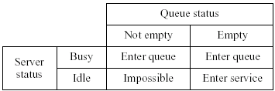
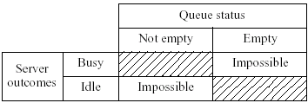
2.3 Simulation of Queueing Systems (7)
Fig. 2.6 Potential unit actions upon arrival
Fig. 2.7 Server outcomes after service completion

Slide 10
2.3 Simulation of Queueing Systems (8)
Simulations of queueing systems generally require the maintenance of an event list for determining what happens next.
Simulation clock times for arrivals and departures are computed in a simulation table customized for each problem.
In simulation, events usually occur at random times, the randomness imitating uncertainty in real life.
Random numbers are distributed uniformly and independently on the interval (0, 1).
Random digits are uniformly distributed on the set {0, 1, 2, … , 9}.
The proper number of digits is dictated by the accuracy of the data being used for input purposes.

Slide 11
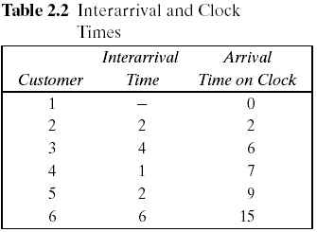
2.3 Simulation of Queueing Systems (9)
Pseudo-random numbers : the numbers are generated using a procedure → detailed in Chapter 7.
Table (Below). Interarrival and Clock Times
Assume that the times between arrivals were generated by rolling a die five times and recording the up face.

Slide 12
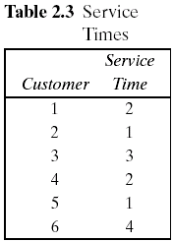
2.3 Simulation of Queueing Systems (10)
Table Service Times
Assuming that all four values are equally likely to occur, these values could have been generated by placing the numbers one through four on chips and drawing the chips from a hat with replacement, being sure to record the numbers selected.
The only possible service times are one, two, three, and four time units.

Slide 13
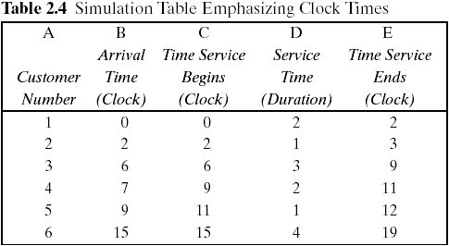
2.3 Simulation of Queueing Systems (11)
The interarrival times and service times must be meshed to simulate the single-channel queueing system.
Table 2.7 was designed specifically for a single-channel queue which serves customers on a first-in, first-out (FIFO) basis.

Slide 14
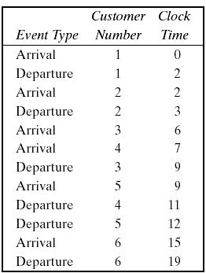
2.3 Simulation of Queueing Systems (12)
Table 2.7 keeps track of the clock time at which each event occurs.
The occurrence of the two types of events(arrival and departure event) in chronological order is shown in Table 2.8 and Figure 2.8.
Figure 2.8 is a visual image of the event listing of Table 2.8.
The chronological ordering of events is the basis of the approach to discrete-event simulation described in Chapter 3.

Slide 15
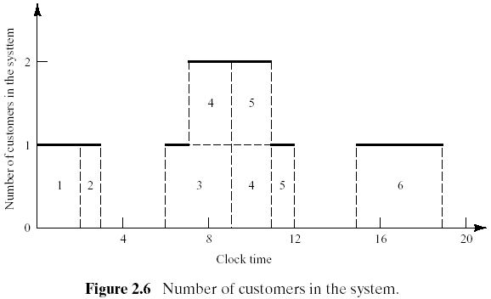
2.3 Simulation of Queueing Systems (13)
Figure 2.8 depicts the number of customers in the system at the various clock times.

Slide 16
2.3 Simulation of Queueing Systems (14)
Example Single-Channel Queue (Example 2.5)
Assumptions
Only one checkout counter.
Customers arrive at this checkout counter at random from 1 to 8 minutes apart. Each possible value of interarrival time has the same probability of occurrence, as shown in Table 1.
The service times vary from 1 to 6 minutes with the probabilities shown in Table 2.
The problem is to analyze the system by simulating the arrival and service of 20 customers.

Slide 17
2.3 Simulation of Queueing Systems (15)
Example (Cont.)
A simulation of a grocery store that starts with an empty system is not realistic unless the intention is to model the system from startup or to model until steady-state operation is reached.
A set of uniformly distributed random numbers is needed to generate the arrivals at the checkout counter. Random numbers have the following properties:
The set of random numbers is uniformly distributed between 0 and 1.
Successive random numbers are independent.
Random digits are converted to random numbers by placing a decimal point appropriately.
Table A.1 in Appendix or RAND() in Excel.
The rightmost two columns of Tables 1 and 2 are used to generate random arrivals and random service times.

Slide 18
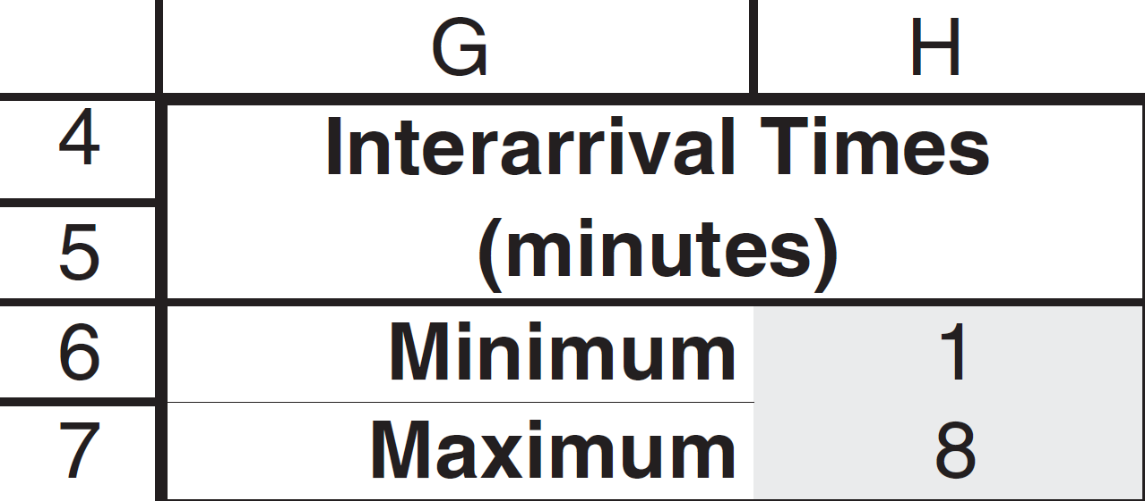
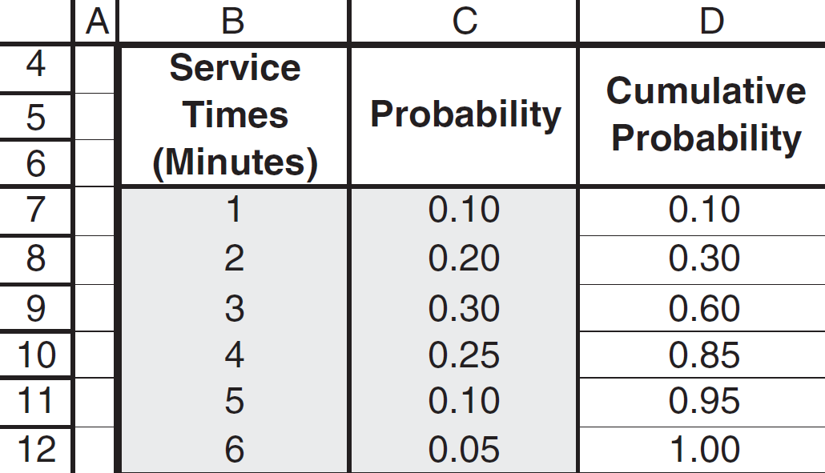
2.3 Simulation of Queueing Systems (16)

Slide 19
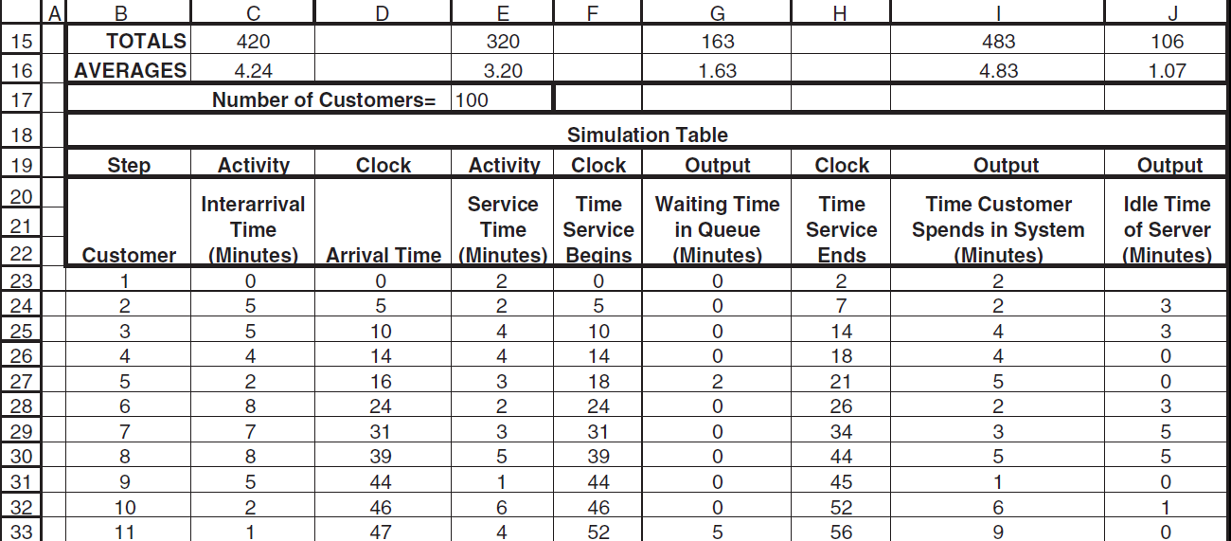
2.3 Simulation of Queueing Systems (16a)
Model responses and simulation table (first 11 customers)

Slide 20
2.3 Simulation of Queueing Systems (20)
Example (Cont.)
The average waiting time for a customer : 1.63 minutes
The probability that a customer has to wait in the queue : 0.46
The fraction of idle time of the server : 0.25
The probability of the server being busy: 0.75 (=1-0.25)

Slide 21
2.3 Simulation of Queueing Systems (21)
Example (Cont.)
The average service time : 3.20 minutes
This result can be compared with the expected service time by finding the mean of the service-time distribution using the equation in table 2.7.
The expected service time is slightly lower than the average service time in the simulation. The longer the simulation, the closer the average will be to

Slide 22
2.3 Simulation of Queueing Systems (22)
Example (Cont.)
The average time between arrivals : 4.24 minutes
This result can be compared to the expected time between arrivals by finding the mean of the discrete uniform distribution whose endpoints are a=1 and b=8.
The longer the simulation, the closer the average will be to
The average waiting time of those who wait : 4.83 minutes

Slide 23
2.3 Simulation of Queueing Systems (23)
Example (Cont.)
The average time a customer spends in the system : 4.83 minutes
average time
customer spends
in the system
average time
customer spends
waiting in the queue
average time
customer spends
in service
=
+
∴ average time customer spends in the system = 1.63 + 3.20 = 4.83 (min)

Slide 24
2.3 Simulation of Queueing Systems (24)
Example 2.6 The Able Baker Carhop Problem
A drive-in restaurant where carhops take orders and bring food to the car.
Assumptions
Cars arrive in the manner shown in Table 2.11.
Two carhops Able and Baker - Able is better able to do the job and works a bit faster than Baker.
The distribution of their service times is shown in Tables 2.12 and 2.13.

Slide 25
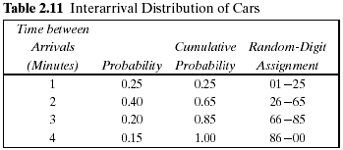
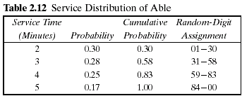
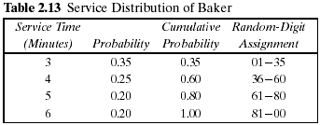
2.3 Simulation of Queueing Systems (25)
Example 2.6 (Cont.)
A simplifying rule is that Able gets the customer if both carhops are idle.
If both are busy, the customer begins service with the first server to become free.
To estimate the system measures of performance, a simulation of 1 hour of operation is made.
The problem is to find how well the current arrangement is working.

Slide 26
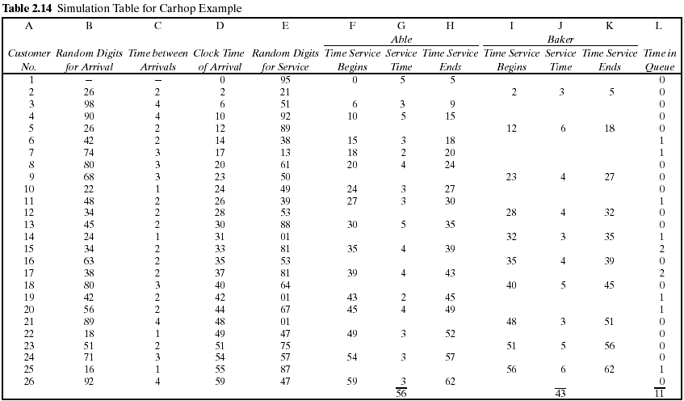

Slide 27
2.3 Simulation of Queueing Systems (26)
Example 2.6 (cont.)
The row for the first customer is filled in manually, with the random-number function RAND() in case of Excel or another random function replacing the random digits.
After the first customer, the cells for the other customers must be based on logic and formulas. For example, the “Clock Time of Arrival” (column D) in the row for the second customer is computed as follows:
D2 = D1 + C2
The logic to computer who gets a given customer can use the Excel macro function IF(), which returns one of two values depending on whether a condition is true or false.
IF( condition, value if true, value if false)

Slide 28
2.3 Simulation of Queueing Systems (27)
Example 2.6 (cont.)
The logic requires that we compute when Able and Baker will become free, for which we use the built-in Excel function for maximum over a range, MAX().
If the first condition (Able idle when customer 10 arrives) is true, then the customer begins immediately at the arrival time in D10. Otherwise, a second IF() function is evaluated, which says if Baker is idle, put nothing (..) in the cell. Otherwise, the function returns the time that Able or Baker becomes idle, whichever is first [the minimum or MIN() of their respective completion times].
A similar formula applies to cell I10 for “Time Service Begins” for Baker.

Slide 29
2.3 Simulation of Queueing Systems (28)
Example 2.6 (Cont.)
For service times for Able, you could use another IF() function to make the cell blank or have a value:
G10 = IF(F10 > 0,new service time, "")
H10 = IF(F10 > 0, F10+G10, "")

Slide 30
2.3 Simulation of Queueing Systems (29)
The analysis of Table 2.14 results in the following:
Over the 62-minute period Able was busy 90% of the time.
Baker was busy only 69% of the time. The seniority rule keeps Baker less busy (and gives Able more tips).
Nine of the 26 arrivals (about 35%) had to wait. The average waiting time for all customers was only about 0.42 minute (25 seconds), which is very small.
Those nine who did have to wait only waited an average of 1.22 minutes, which is quite low.
In summary, this system seems well balanced. One server cannot handle all the diners, and three servers would probably be too many. Adding an additional server would surely reduce the waiting time to nearly zero. However, the cost of waiting would have to be quite high to justify an additional server.

Slide 31
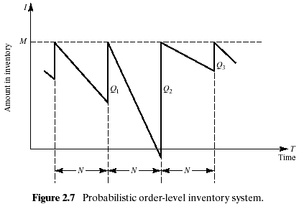
2.4 Simulation of Inventory Systems (1)
This inventory system has a periodic review of length N, at which time the inventory level is checked.
An order is made to bring the inventory up to the level M.
In this inventory system the lead time (i.e., the length of time between the placement and receipt of an order) is zero.
Demand is shown as being uniform over the time period

Slide 32
2.4 Simulation of Inventory Systems (2)
Notice that in the second cycle, the amount in inventory drops below zero, indicating a shortage.
Two way to avoid shortages
Carrying stock in inventory
: cost - the interest paid on the funds borrowed to buy the items, renting of storage space, hiring guards, and so on.
Making more frequent reviews, and consequently, more frequent purchases or replenishments
: the ordering cost
The total cost of an inventory system is the measure of performance.
The decision maker can control the maximum inventory level, M, and the length of the cycle, N.
In an (M,N) inventory system, the events that may occur are: the demand for items in the inventory, the review of the inventory position, and the receipt of an order at the end of each review period.

Slide 33
2.4 Simulation of Inventory Systems (3)
Example 2.7 The Newspaper Seller’s Problem
A classical inventory problem concerns the purchase and sale of newspapers.
The paper seller buys the papers for 33 cents each and sells them for 50 cents each. (The lost profit from excess demand is 17 cents for each paper demanded that could not be provided.)
Newspapers not sold at the end of the day are sold as scrap for 5 cents each. (the salvage value of scrap papers)
Newspapers can be purchased in bundles of 10. Thus, the paper seller can buy 50, 60, and so on.
There are three types of newsdays, “good,” “fair,” and “poor,” with probabilities of 0.35, 0.45, and 0.20, respectively.

Slide 34
2.4 Simulation of Inventory Systems (4)
Example 2.3 (Cont.)
The problem is to determine the optimal number of papers the newspaper seller should purchase.
This will be accomplished by simulating demands for 20 days and recording profits from sales each day.
The profits are given by the following relationship:
The distribution of papers demanded on each of these days is given in Table 2.15.
Tables 2.16 and 2.17 provide the random-digit assignments for the types of newsdays and the demands for those newsdays.

Slide 35
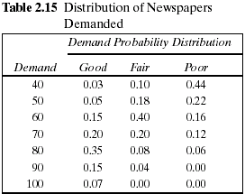
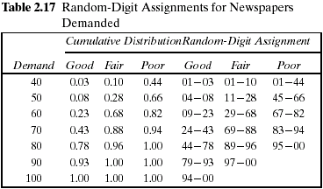
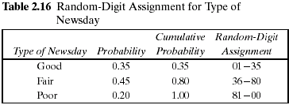
2.4 Simulation of Inventory Systems (5)

Slide 36
2.4 Simulation of Inventory Systems (6)
Example 2.7 (Cont.)
The simulation table for the decision to purchase 70 newspapers is shown in Table 2.18.
The profit for the first day is determined as follows:
Profit = $30.00 - $23.10 - 0 + $.50 = $7.40
On day 1 the demand is for 60 newspapers. The revenue from the sale of 60 newspapers is $30.00.
Ten newspapers are left over at the end of the day.
The salvage value at 5 cents each is 50 cents.
The profit for the 20-day period is the sum of the daily profits, $174.90. It can also be computed from the totals for the 20 days of the simulation as follows:
Total profit = $645.00 - $462.00 - $13.60 + $5.50 = $174.90
The policy (number of newspapers purchased) is changed to other values and the simulation repeated until the best value is found.

Slide 37
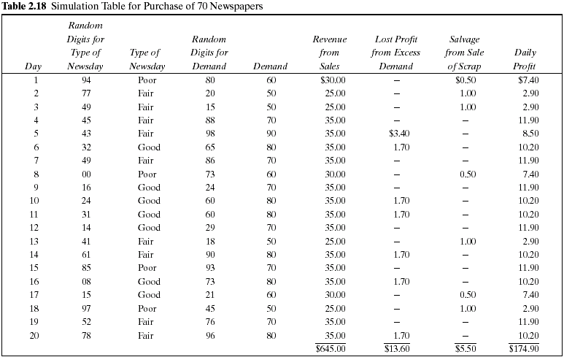

Slide 38
2.4 Simulation of Inventory Systems (7)
Practice Example.
Example 2.8 Simulation of an (M,N) Inventory System
This example follows the pattern of the probabilistic order-level inventory system shown in Figure 2.7.
Suppose that the maximum inventory level, M, is11 units and the review period, N, is 5 days. The problem is to estimate, by simulation, the average ending units in inventory and the number of days when a shortage condition occurs.
The distribution of the number of units demanded per day is shown in Table 2.19.
In this example, lead time is a random variable, as shown in Table 2.20.
Assume that orders are placed at the close of business and are received for inventory at the beginning of business as determined by the lead time.

Slide 39
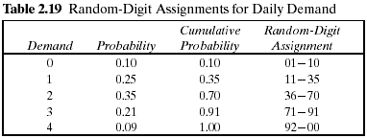
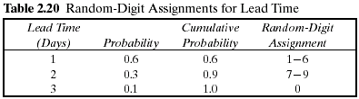
2.4 Simulation of Inventory Systems (8)
Example 2.8 (Cont.)
For purposes of this example, only five cycles will be shown.
The random-digit assignments for daily demand and lead time are shown in the rightmost columns of Tables 2.19 and 2.20.

Slide 40
Summary
This chapter introduced simulation concepts via examples in order to illustrate general areas of application and to motivate the remaining chapters.
Ad hoc simulation tables were used in completing each example. Events in the tables were generated using uniformly distributed random numbers and, in one case, random normal numbers.
The examples illustrate the need for determining the characteristics of the input data, generating random variables from the input models, and analyzing the resulting response.

